Slide 1
Frequent words with mismatches and reverse compliment
21BIO112 INTELLIGENCE OF BIOLOGICAL SYSTEMS

Slide 2

GROUP NO 13
MEET THE TEAM
● S HARI SANKAR AM.EN.U4AIE21056
● SAI MANASA SOUMYA AM.EN.U4AIE21057
● R RAKESH AM.EN.U4AIE21052
● K SUBHASH AM.EN.U4AIE21036
● CHERISHMA AKSHAYA AM.EN.U4AIE21051

Slide 3

01
INTRODUCTION
02
TABLE OF CONTENTS
03
04
METHODOLOGY
RESULTS
CONCLUSIONS

Slide 4
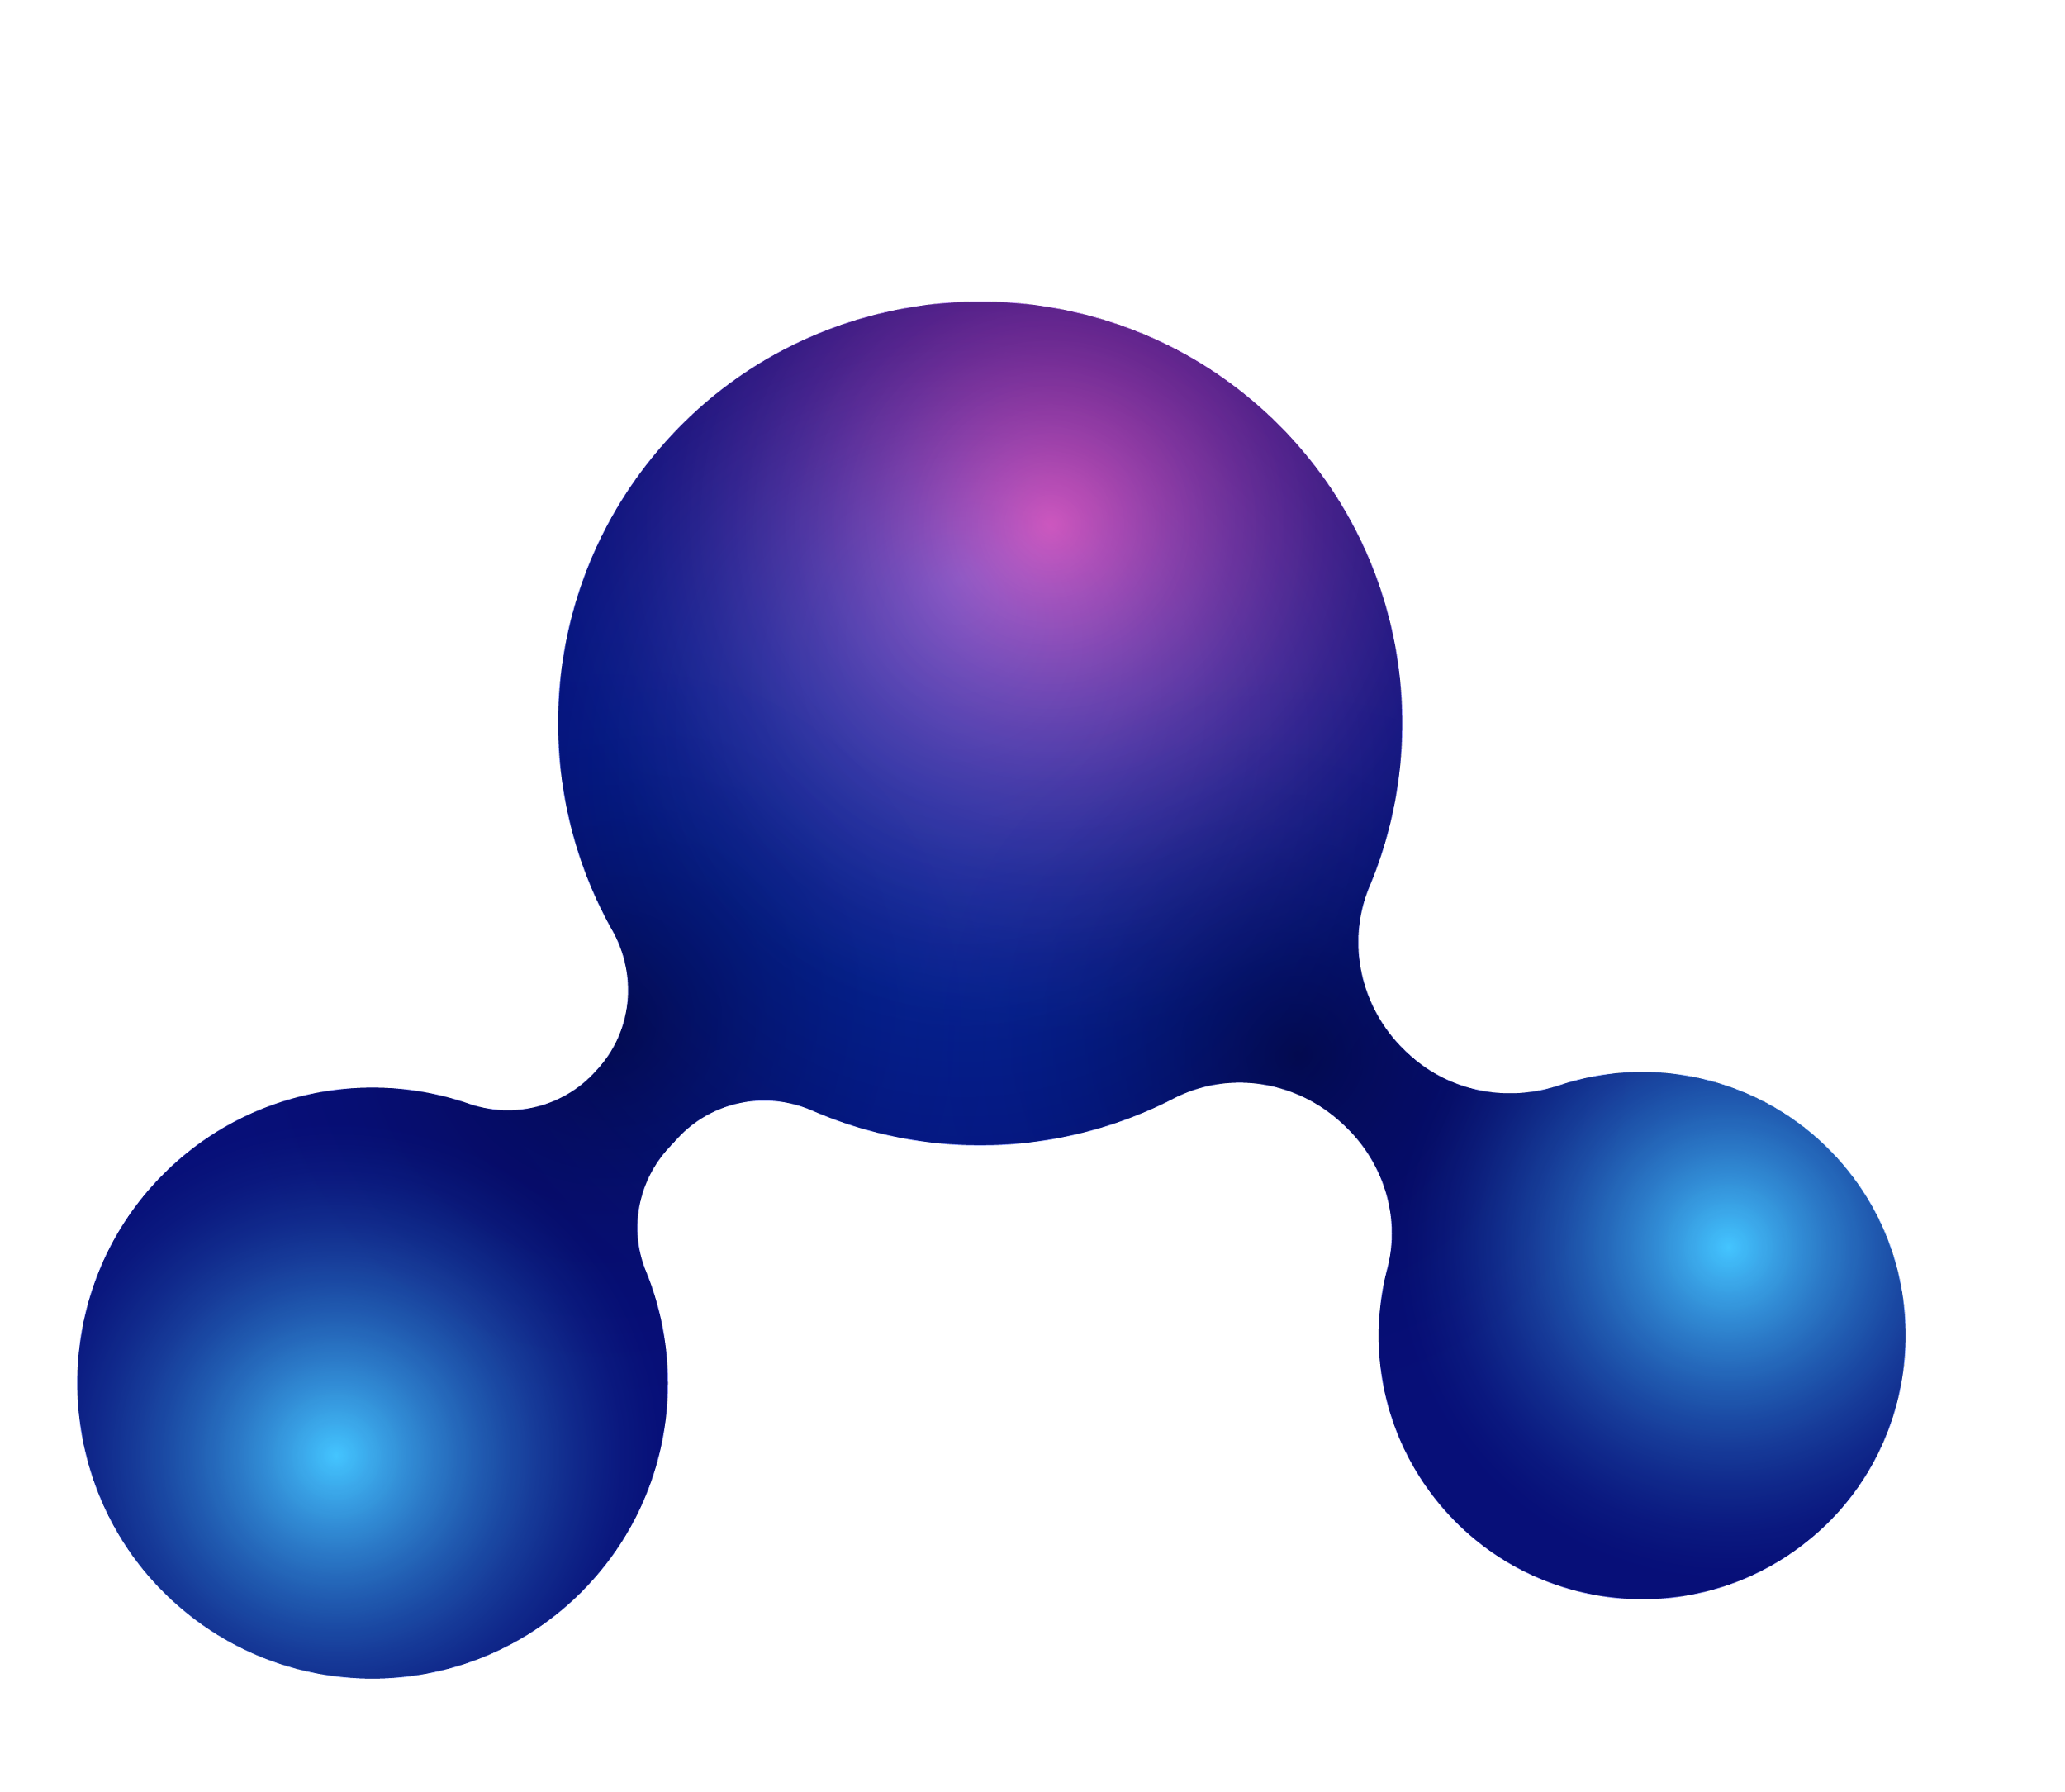
01
INTRODUCTION
PROBLEM STATEMENT
OBJECTIVE

Slide 5
PROBLEM STATEMENT
By using advanced methods like the minimum skew problem, we find an approximate location of Oric at position 3923620 in E. coli Genome.
After using the Frequent Words Problem to solve in a window of length 500 starting at position 3923620 of the genome reveals no 9-mers that appear three or more time.
Even if we have managed to locate Oric in E. coli, it appears that we still have not found the DnaA boxes that jump-start replication in this bacterium.
objective
In this project, our goal is to modify our previous algorithm for the Frequent Words Problem in order to find DnaA boxes by identifying frequent k-mers, possibly with mismatches. Given strings Text and Pattern as well as an integer d, we define COUNT d (Text, Pattern) as the number of occurrences of Pattern in Text with at most d mismatches.

Slide 6

02
METHODOLOGY

Slide 7
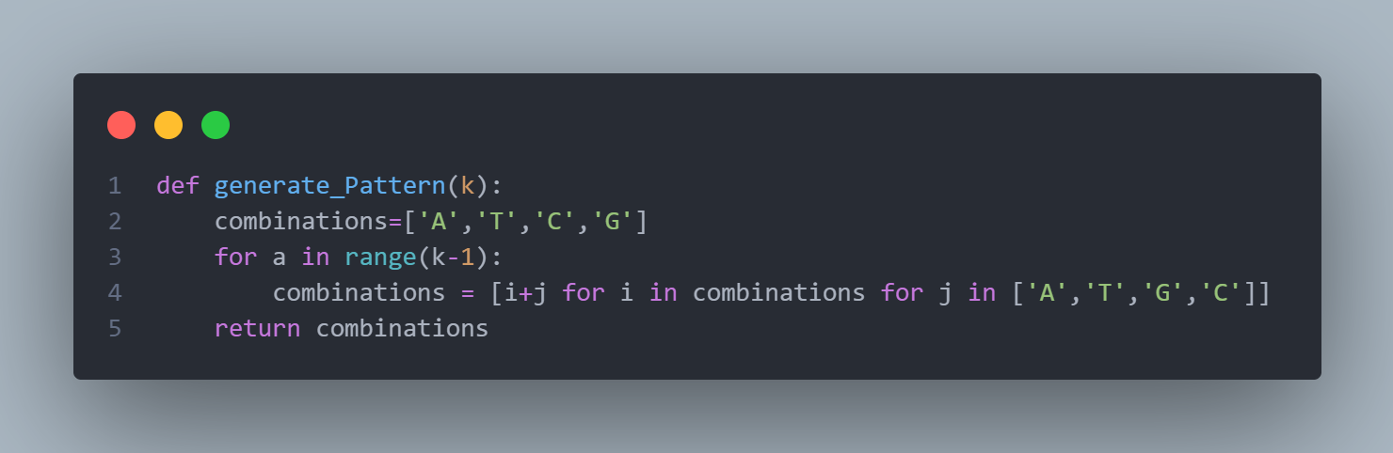
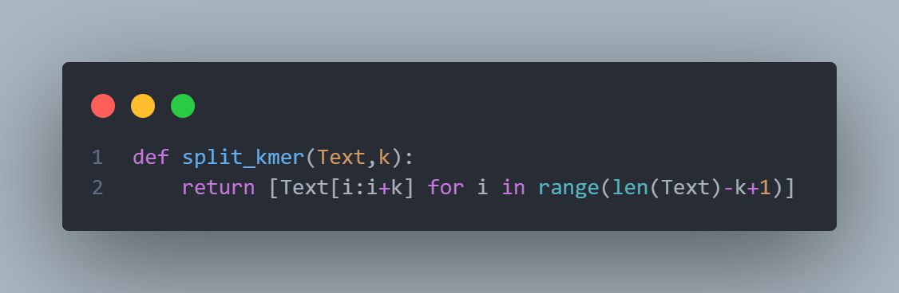
IMPLEMENTATION
01. GENERATING ALL POSSIBLE KMER PATTERN
02. SplITTING A TEXT INTO KMERS
For example if k value is 3 then a can be 0,1
When a = 0, combinations = [AA AT…….GC]
When a = 1, combinations = [AAA AAT…..GCC] as combinations have been updated in the previous iteration

Slide 8

MAIN FUNCTIONS USED
REVERSE COMPLIMENT PROBLEM
HAMMING DISTANCE
01
02
Finding the reverse complement of a particular string
Finding the hamming distance between 2 strings
APPROXIMATE PATTERN COUNT
03
04
MAIN FUNCTION
Similar to pattern count but we will count the approximate occurrences of a pattern
The function for frequent words with mismatches and reverse complement

Slide 9
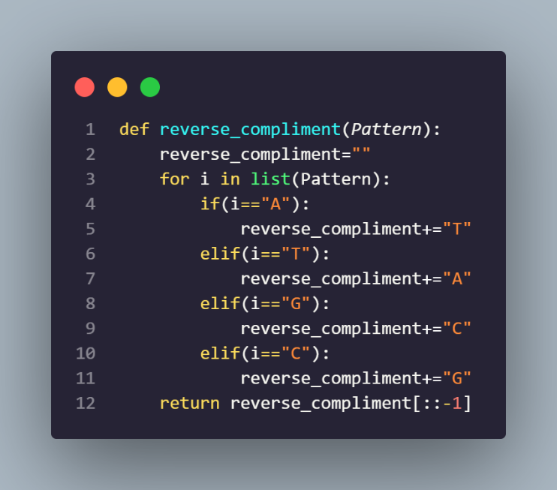
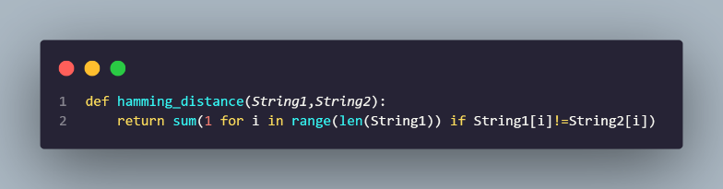
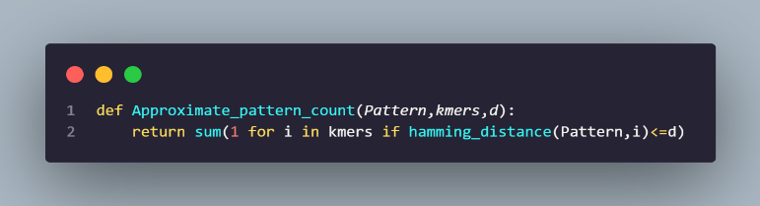
IMPLEMENTATION
REVERSE COMPLIMENT
HAMMING DISTANCE
02. APPROXIMATE PATTERN COUNT

Slide 10
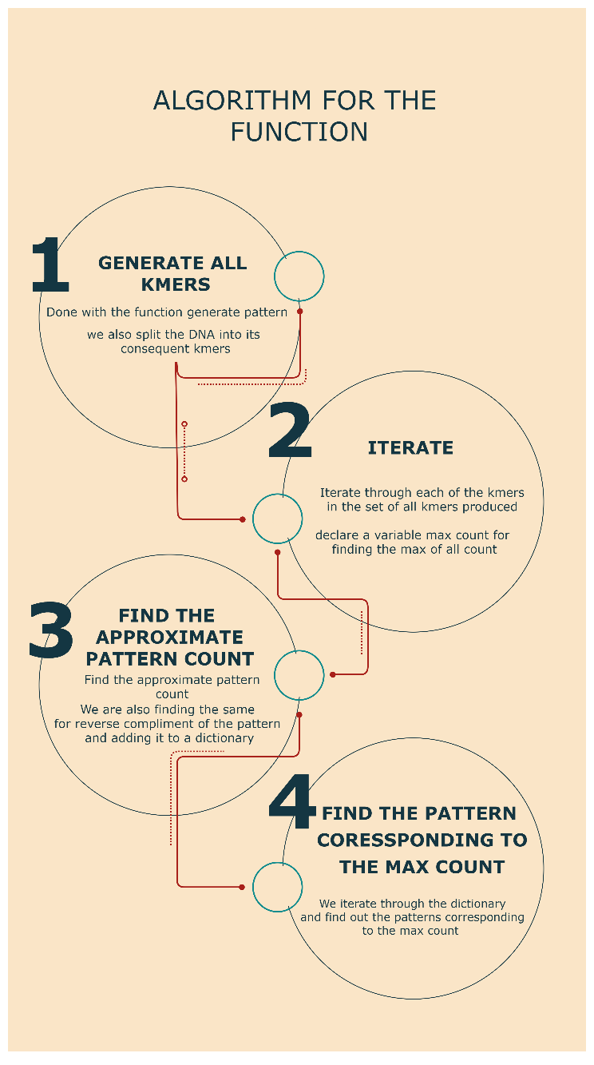
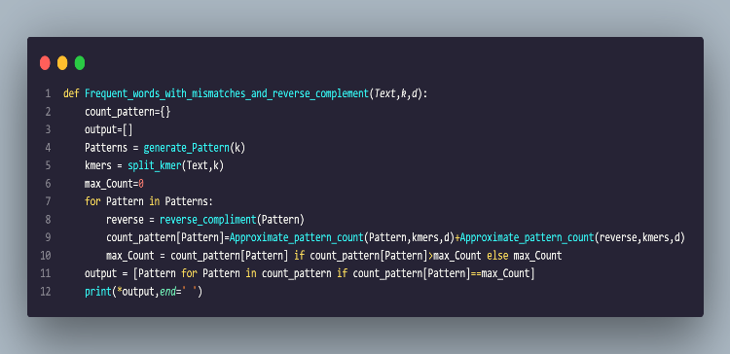
ALGORITHM FLOW CHART
FUNCTION IMPLEMENTATION

Slide 11
RESULTS

Slide 12
DATASET 1
DATASET 2
DATASET 3
DNA STRING
ACGTTGCATGTCGCATGATGCATGAGAGCT
K VALUE – 4
D VALUE – 1
DNA STRING
AGTCAGTC
K VALUE – 4
D VALUE – 2
DNA STRING
AATTAATTGGTAGGTAGGTA
K VALUE – 4
D VALUE – 0
OUTPUT
ATGT ACAT
OUTPUT
AATT GGCC
OUTPUT
AATT

Slide 13
CONCLUSIONS
Thus, we can conclude from this project that the frequent words with mismatches is an efficient algorithm for finding the replication origin in a genomic sequence. The dataset output when tested in the Rosalind website, showed positive results. Another thing which we can conclude that from the problem that we have completed in the project is that bioinformatics when combined with computational engineering techniques can help us to identify the basics of life. It will intern result in future efficient technologies which may even include stopping cureless diseases and conditions like cancers.

Slide 14
REFFERENCES
https://rosalind.info/problems/ba1j/explanation/
http://dspace.uiu.ac.bd/bitstream/handle/52243/2123/A_Novel_Approach_to_Predict_the_Origin_of_Replication.pdf?sequence=1&isAllowed=
https://algorithmcode.wordpress.com/2014/09/20/dna-replication-frequent-words-reverse-complement-pattern-matching-clump-finding-skewi-mismatches/

